Slide 1

Registry Editor
By: Dana Mohammed Al-Mahrouk

Slide 2



Setting & Configuration of Application
Where are application configuration settings saved?
font type and style in Word or character design for a game you play.
Application ➔ (color, font size, screen size, path install program & setting, version ,update & upgrade)
Your personality on the device, your preferences for design and organization.

Slide 3
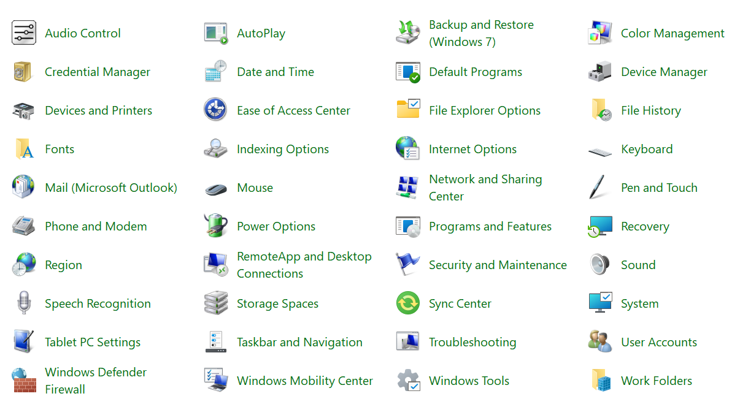

Slide 4

Past
Program settings were stored in separate files distributed throughout the system.
.ini → initialization file
attrib <+-[ S | H | R ]> <file-name>
A → Read for archiving (default)
S → file system
H → Hidden file
R → read only

Slide 5
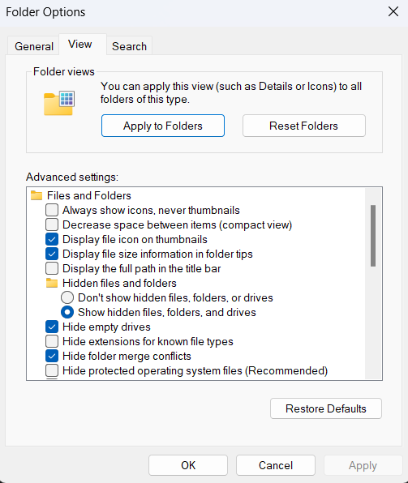
.ini Files
Show Hidden items.
uncheck → Hide protected operating system files (Recommended)

Slide 6
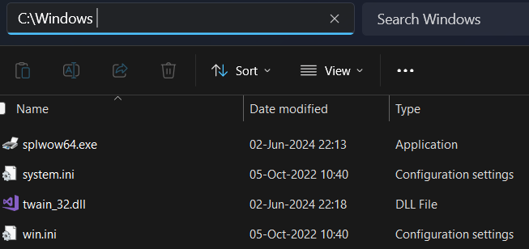
.ini
Configuration files used by Windows operating systems.
System.ini: is a legacy configuration file (older Windows), used to configure system-level settings, such as device drivers, memory management, and other system components.
Win.ini: legacy configuration file (older Windows). store settings about user interface and some application settings, such as fonts, colors, and other environment settings.
Desktop.ini

Slide 7
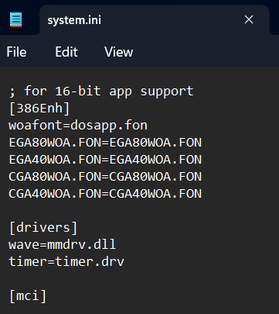
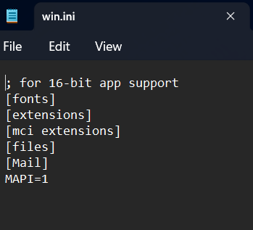
System.ini & Win.ini

Slide 8
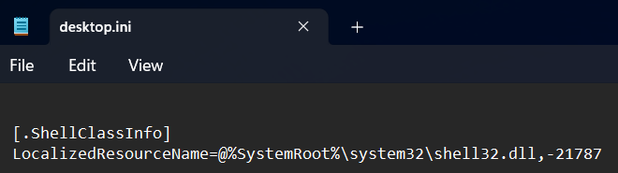
Desktop.ini
is used in modern versions of Windows to store folder customization settings. It allows users to assign a custom icon to a folder, change the folder's display name, …etc.
C:\Users\almah\AppData\Roaming\Microsoft\Windows\Start Menu\Programs\Startup\desktop.ini
C:\ProgramData\Microsoft\Windows\Start Menu\Programs\Startup\desktop.ini
Section
Key = Value

Slide 9
C:\Windows\System32\config
containing files that are essential for the system's configuration and operation. This directory stores the Windows Registry's hive files, which hold the configuration settings for the operating system and installed applications.
SYSTEM: Contains system-related settings, including hardware configurations, device drivers, and services.
SOFTWARE: Stores settings for installed software and applications.
SAM: Stores the Security Accounts Manager (SAM) database, which includes information about user accounts and passwords.
SECURITY: Contains security settings, including policies and permissions.
DEFAULT: Stores settings for the default user profile.
config\RegBack: backup copies recovery in case of corruption or failure.
.LOG: changes to the registry are correctly recorded (system updates or changes)
C:\Windows\System32\winevt\Logs: files related to event logs

Slide 10
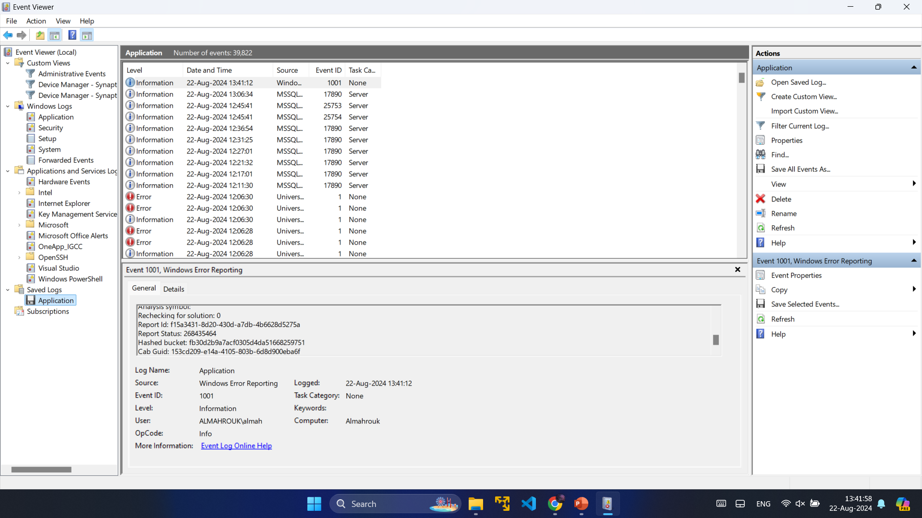

Slide 11
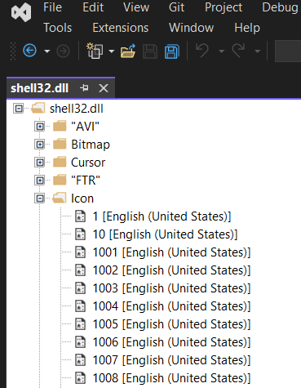
Ex 1: Change Folder Icon
Create folder → “My Folder” → Properties → Customize → Change Icon → Star “C:\WINDOWS\System32\SHELL32.dll”
Look Icons: %SystemRoot%\System32\SHELL32.dll
Dll (Dynamic Link Library) file contain code, data, and resources that multiple programs can use to perform specific tasks, such as managing memory, displaying text, or interacting with hardware.

Slide 12
.ini Properties
Properties of this file:
It can be shared with people & easy editing.
No Windows permissions required ➔
Not registered on Windows
Problems dealing with firewall
Several programs can take their settings from the same file and modify it (using the key) (the file is locked)
One program can take its settings from several configuration files
Available to all users
If the file is deleted or lost, the program will not be able to work
Program 1
1.ini
Program 2
2.ini

Slide 13

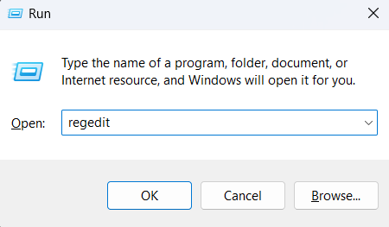
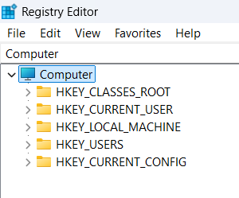
Windows Registry
Started with Windows 95, Any problem with it, the operating system will not work, install a new Windows
Open
Registry Editor
Win + R → regedit
Hives

Slide 14
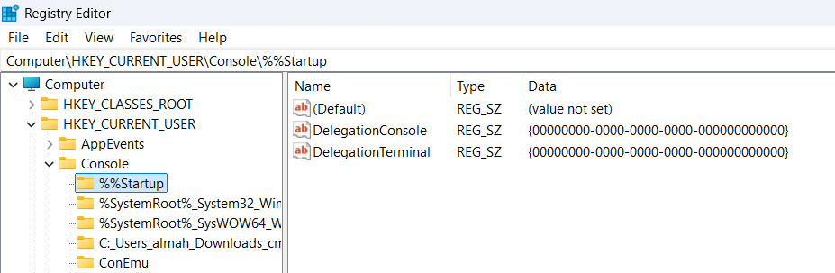
Values
Hives
Keys
Value name
Value
type
Value data
Sub-
Keys

Slide 15
Windows Registry Editor
Centralize place that save some application configuration setting.
Is a hierarchical DB that store configuration setting & option on Microsoft OS it used to share information about the system, application & users.
Application ➔ (color, font size, screen size, path install program & setting, version ,update & upgrade)
Device ➔ (name, username, language, time zone, disktop background, keyboard – mouse – screen setting, power, …etc)
Windows + NIC + Firewall + …
You can backup Registry Editor.

Slide 16
Value Data Types
REG_SZ (String Value) → file paths, names
REG_MULTI_SZ (Multi-String Value) → list of values or multiple file paths (\0)
REG_EXPAND_SZ (Expandable String Value) → automatically expanded (dynamic) by the system. (environment variables like `%SystemRoot%` or `%ProgramFiles%`)
REG_DWORD (32-bit Number) → numeric values, such as flags, counters (`0x00000001`)
REG_QWORD (64-bit Number) → large numeric values (`0x0000000000000001`)

Slide 17
Value Name
Default Value (Unnamed Value): `(Default)` or `@` → store the primary or most important setting for that key.
Named Values: specific names that identify the type of data stored in them.
`Path`: Stores file paths or directory locations.
`Version`: Indicates the version of an application or component.
`Enabled`: A flag, often stored as a `REG_DWORD`, indicating whether a feature is enabled (`1`) or disabled (`0`).
`(Default)`: The unnamed default value, often used for primary settings.
`DisplayName`: Stores the name of an application or service as it should appear in the user interface.
`ServiceDll`: Specifies the DLL used by a service

Slide 18
Hives
HKEY_CLASSES_ROOT (HKCR):
Contains file associations and OLE (Object Linking and Embedding) object classes. It links file extensions to the applications that handle them and defines the COM (Component Object Model) objects used by applications.
Usage: When you double-click a file in Windows Explorer, the settings in this hive determine which application is launched to open the file.
HKEY_CURRENT_USER\SOFTWARE\CLASSES
HKEY_LOCAL_MACHINE → Software → Classes → .docx → Word.Document.12 → ShellNew → File Name
16-bit programmer

Slide 19
Hives
HKEY_CURRENT_USER (HKCU): (User Level)
configuration settings for the currently logged-in user. It includes settings like desktop configurations, user-specific software configurations, and user preferences.
The hive is stored in the `Ntuser.dat` file located in the user's profile directory (`C:\Users\Username`).
Ex: Run App Automatically when device Run
HKEY_CURRENT_USER → Software → Microsoft → Windows → CurrentVersion → Run
To Add: right click → new → String Value → [Name] , → modify → Value Data → [path.exe]
Ex: HKEY_CURRENT_USER → Software → Adobe → Photoshop → 160.0
Ex: HKEY_CURRENT_USER → Software → Python → PythonCore → 3.10
Notes:
The `Ntuser.dat` file is a critical system file in Windows that stores a user's profile information and settings. It includes data such as registry settings, custom desktop configurations, and application-specific settings. Each user account on a Windows system has its own `Ntuser.dat` file, located in the user's profile directory (e.g., `C:\Users\Username\Ntuser.dat`).

Slide 20
Hives
HKEY_LOCAL_MACHINE (HKLM): (Device Level)
Stores settings and configurations that apply to all users on the computer.
Contains system-wide settings such as hardware configurations, installed software, system services, and more.
Subkeys:
SAM: Security Accounts Manager database, which stores user account information.
SECURITY: Security-related settings, policies, and audit settings.
SYSTEM: System configuration, including services and drivers.
SOFTWARE: Installed software information and their settings.

Slide 21
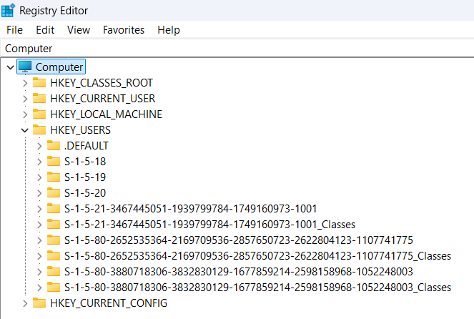
Hives
HKEY_USERS (HKU):
Contains settings for all user profiles on the computer.
including the default profile and the currently logged-in user's settings.
SID (Security identifier)
User ID
HKEY_CURRENT_USER && HKEY_USERS

Slide 22
Hives
HKEY_CURRENT_CONFIG (HKCC):
Provides a snapshot of the current hardware configuration, including settings that are dynamic and change depending on the hardware state.

Slide 23
Add & Remove program
program’s GUID (Globally Unique Identifier)
Computer\HKEY_LOCAL_MACHINE\SOFTWARE\Microsoft\Windows\CurrentVersion\Uninstall
Computer\HKEY_LOCAL_MACHINE\SOFTWARE\WOW6432Node\Microsoft\Windows\CurrentVersion\Uninstall
HKEY_LOCAL_MACHINE\SYSTEM\CurrentControlSet\Services\SharedAccess\Parameters\FirewallPolicy
HKEY_LOCAL_MACHINE\SYSTEM\CurrentControlSet\Services\Tcpip\Parameters
HKEY_LOCAL_MACHINE\SYSTEM\CurrentControlSet\Services\NlaSvc\Parameters\Internet
HKEY_LOCAL_MACHINE\SYSTEM\CurrentControlSet\Services\SharedAccess\Parameters\FirewallPolicy\DomainProfile

Slide 24
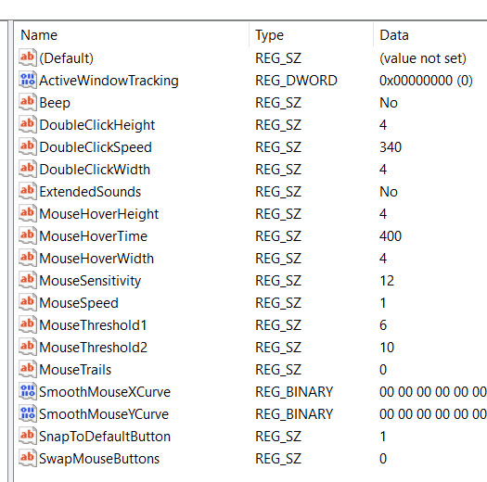
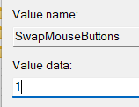
Control Panel → Mouse
Mouse:
Computer\HKEY_CURRENT_USER\Control Panel\Mouse
MouseSensitivity → change
SwapMouseButtons = 1
Key Name
Data Type

Slide 25
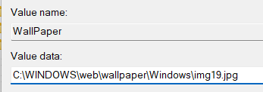
Control Panel → Desktop
Computer\HKEY_CURRENT_USER\Control Panel\Desktop
WallPaper

Slide 26
Disk Space Message
Computer\HKEY_CURRENT_USER\Software\Microsoft\Windows\CurrentVersion\Policies
→ right click → new key → Explorer → right click → new Dword → “NoLowDiskSpaceChecks” = 1
Message Confirm Delete File of Folder
Computer\HKEY_CURRENT_USER\Software\Microsoft\Windows\CurrentVersion\Policies
right click → new Dword → “ConfirmFileDelete” = 0

Slide 27
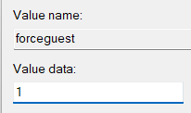
Login as a Gust
No password
Computer\HKEY_LOCAL_MACHINE\SYSTEM\CurrentControlSet\Control\Lsa

Slide 28
Add Item to right click menu
Computer\HKEY_CLASSES_ROOT\Directory\Background\shell
Then right click → New → key → <put name> → right click → key → “command” → data value of default name “Program path.exe”

Slide 29

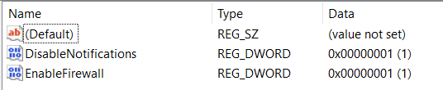
Turn Off Firewall
Computer\HKEY_LOCAL_MACHINE\SYSTEM\CurrentControlSet\Services\SharedAccess\Parameters\FirewallPolicy\StandardProfile
DisableNotifications = 0
EnableFirewall = 0

Slide 30
Open Port
Computer\HKEY_LOCAL_MACHINE\SYSTEM\CurrentControlSet\Services\SharedAccess\Parameters\FirewallPolicy\FirewallRules

Slide 31
Virus/Program Run when Windows Open
Computer\HKEY_LOCAL_MACHINE\SOFTWARE\Microsoft\Windows\CurrentVersion\Run
New string → Data Value = “program path”

Slide 32

Thank You

